Slide 1

Cursor Pointer Control Using Eye and Hand Gestures
UQ22CA741A - Capstone Project - Phase 2
Student Details
Guide Details
Name : BHARATH.S
SRN : PES1PG22CA044
Mr. Santosh S Katti
Assistant Professor

Slide 2
Cursor Pointer Control Using Eye and Hand Gestures
Abstract
This project explores an innovative approach to human-computer interaction by combining eye and hand gestures to control the cursor pointer on a computer screen.
The traditional input devices such as a mouse or touchpad are augmented with a system that utilizes both eye tracking technology and hand gestures for a more intuitive and immersive user experience.
The proposed system, helps the users in controlling a desktop without the usage of the mouse.
The proposed system will use the concepts of eye gestures and hand gestures to control the mouse.

Slide 3
Cursor Pointer Control Using Eye and Hand Gestures
Problem Scenario
Interacting with a computer cursor using the standard mouse or touchpad can be a bit tricky and uncomfortable for many users.
Many individuals, regardless of age or ability, encounter difficulties in navigating the computer interface using standard input devices.
This problem is further compounded by the potential for discomfort and repetitive strain injuries by using the traditional mouse. The conventional input devices might not provide the ease and comfort desired for an computing experience.

Slide 4
Cursor Pointer Control Using Eye and Hand Gestures
Proposed Solution
This project focuses on revolutionizing the way we interact with the computer cursor by eliminating the need for a conventional mouse or touchpad.
The project aims to address the difficulties associated with traditional cursor control methods, seeking to provide a more accessible and user-friendly alternative.

Slide 5
Cursor Pointer Control Using Eye and Hand Gestures
Scope
The project may face limitations in scenarios where the user is operating in complete darkness. The absence of adequate ambient light could hinder the effectiveness of eye and hand tracking technology, leading to decreased performance.
The success of the project relies on the quality of the camera used for eye and hand gesture tracking. Low-resolution or poorly calibrated cameras may compromise the precision and responsiveness of the system.

Slide 6
Cursor Pointer Control Using Eye and Hand Gestures
Literature Survey
Summary:
In 2013, a system was developed which used eye tracking system. It uses different eye-tracking techniques to make the system reliable. The issue in this system is that if any liquid is found in eyes, it will not work. Like female use eyeliner or mascara in their eyes, so the system stops working in those situations._{[1]}
Title:- Eye tracking mouse for human computer interaction
Published in:- 2013 E-Health and Bioengineering Conference (EHB)
Authors:-Robert Gabriel Lupu, Florina Ungureanu, Valentin Siriteanu.

Slide 7
Cursor Pointer Control Using Eye and Hand Gestures
Literature Survey
Summary:
In 2014, a face and eye-controlled system were developed which were based on MATLAB.It uses a webcam to control the mouse by eye and face movement. The issue in this system is that this system only works in a few centimeter radius. _{[2]}
Title:- Face and eye tracking for controlling computer functions
Published in:- 2014 11th International Conference on Electrical Engineering/Electronics, Computer, Telecommunications and Information Technology (ECTI-CON)
Authors:-Chairat kraichan, Suree Pumrin

Slide 8
Cursor Pointer Control Using Eye and Hand Gestures
Literature Survey
Summary:-
In 2015, a Pupil center coordinate detection using the circular Hough transform technique was introduced. In this system, the webcam uses Hough Transform Techniques to detect the pupil of a person. The issue in this system was that it takes a lot of time and is not a real-time system. It first captures the body after that, it move to face then eyes and finally to the pupil taking a lot of time. _{[3]}
Title:- Pupil centre coordinates detection using the circular Hough transform technique
Published in: 2015 38th International Spring Seminar on Electronics Technology (ISSE)
Authors:-Radu Gabriel Bozomitu, Alexandru pasarica, Vlad Cehan, Cristian Rotariu, Constantin Barabasa

Slide 9
Cursor Pointer Control Using Eye and Hand Gestures
Literature Survey
Summary:-
In 2020 Gubbala Durga Prasanth and P. Srinivas Reddy proposed a paper on “Virtual mouse implementation using OpenCV”. They used OpenCV, Deep learning, NumPy and anaconda technology. Its major drawback is that it is very complex to use._{[4]}
Title Virtual Mouse Implementation using Open CV.
Published in: Journal of Emerging Technologies and Innovative Research (JETIR).
Authors:- Gubbala Durga Prasanth and P. Srinivas Reddy.

Slide 10
Cursor Pointer Control Using Eye and Hand Gestures
Literature Survey
Summary:-
In 1990, Quam introduced an early hardware-based system; in this system, the user should wear a Data Glove. The proposed system by Quam although gives results of higher accuracy, but it is difficult to perform some of the gesture controls using the system. Data Gloves typically had sensors embedded in the glove to detect hand and finger movements. While they could provide a more accurate representation of hand gestures compared to some other methods, they did have limitations._{[5]}
Title:- Gesture recognition with a Data Glove.
Published in: IEEE Conference on Aerospace and Electronics.
Authors:- D. L. Quam

Slide 11
Cursor Pointer Control Using Eye and Hand Gestures
Comparison
Current System | Existing System
Can work in long radius, real time output and can work in different conditions. | Faces challenges such as limited working radius, time consuming processes, and sensitive to external factors like liquid in the eyes.
Real-time tracking of eyes and hands and responding to user’s input. | Faces issues of slow eye and hand tracking and may require high quality computer systems.
Built using Python as programming language and uses various libraries. | Built using MATLAB.
ensures adaptability to various eye and hand conditions, ensuring optimal effectiveness for users with different eye shapes and sizes. | Fail to adapt to various eye and hand conditions such as different eye shapes and sizes.

Slide 12
Cursor Pointer Control Using Eye and Hand Gestures
Tools and Technologies
Python---v3.8.10
OpenCv---v4.8.1
Mediapipe---v0.10.9
Pyauto GUI---v0.9.54

Slide 13
Cursor Pointer Control Using Eye and Hand Gestures
Requirement Analysis
Hardware Requirements
Laptop or PC with Web Camera
8GB RAM
256GB SSD/HDD
Intel i3 /AMD Ryzen 5 processor
Software Requirements
Operating system---windows

Slide 14
Cursor Pointer Control Using Eye and Hand Gestures
Functional Requirements
Eye Tracking:-The system uses a camera to track the user's eyes, it need to initially detect and recognize the user's face to establish a reference point for eye tracking.
Hand Tracking:-The Hand gesture recognition involves capturing and interpreting movements and positions of the user's hand.
Scrolling:-Scrolling on the window using hand gestures typically involves navigating content on a display, such as scrolling through a document, webpage, or other graphical user interface elements.
Cursor Control:-The system allows users to control the on-screen cursor using their right eye movements and hand gestures.
Click Actions:- Users have the capability to perform click actions through eye blinks and through hand gestures.
Volume Control:-Integrating volume control into a system that uses hand gestures for interaction involves recognizing specific gestures.
Drag and Drop:-Integrating drag and drop functionality using hand gestures involves recognizing specific gestures.

Slide 15
Cursor Pointer Control Using Eye and Hand Gestures
Non-Functional Requirements
Performance:-The system responds to user eye movements with minimum latency to provide a seamless and responsive user experience. Eye location tracking accuracy is high.
Usability:-The system will be easy to learn and use, even for individuals with limited computer experience.
Reliability:-The system operates reliably over extended periods of use, with minimal errors or crashes .The system will be able to handle errors gracefully and recover from failures.
Adaptability to Different Conditions:-The system ensures adaptability to various eye conditions, ensuring optimal effectiveness for users with different eye shapes and sizes. The system is capable of accurately tracking eye movements, regardless of variations in eye shapes and sizes among different users.

Slide 16
Cursor Pointer Control Using Eye and Hand Gestures
Architecture Diagram
Eye Tracking
Hand Gesture Recognition
Control volume
User Interface
User
Click Operations
Scrolling
Drag and Drop
Presentation Layer
Business Layer
Service Layer

Slide 17
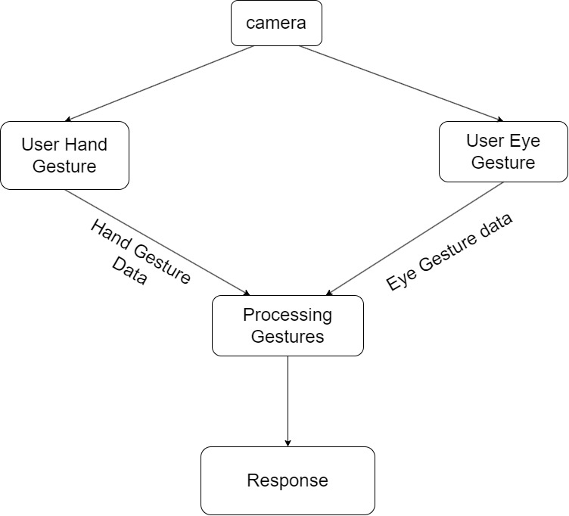
Cursor Pointer Control Using Eye and Hand Gestures
Block Diagram

Slide 18

Cursor Pointer Control Using Eye and Hand Gestures
Process Flow
Start
Choose between
eye and hand
Access Camera
And start
capturing video
End
Close camera
Detect Face/Eye
Click Gesture
Drag and Drop
Gesture
Scrolling
Gesture
Volume
Gesture
Provide Input
from Eye/Hand
gestures
Movement
Gesture
No
No
No
No
Stop
yes
yes
yes
yes
yes
Move the
Cursor
Operate Cursor
Clicks
Perform Drag
and Drop
Perform Scrolling
Increase/Decrease
Volume

Slide 19
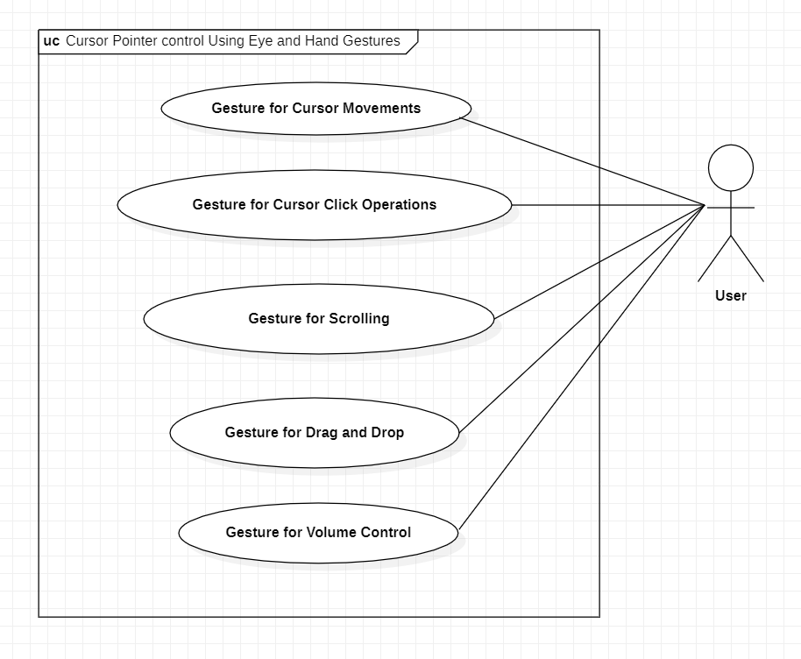
Cursor Pointer Control Using Eye and Hand Gestures
Use Case Diagram

Slide 20
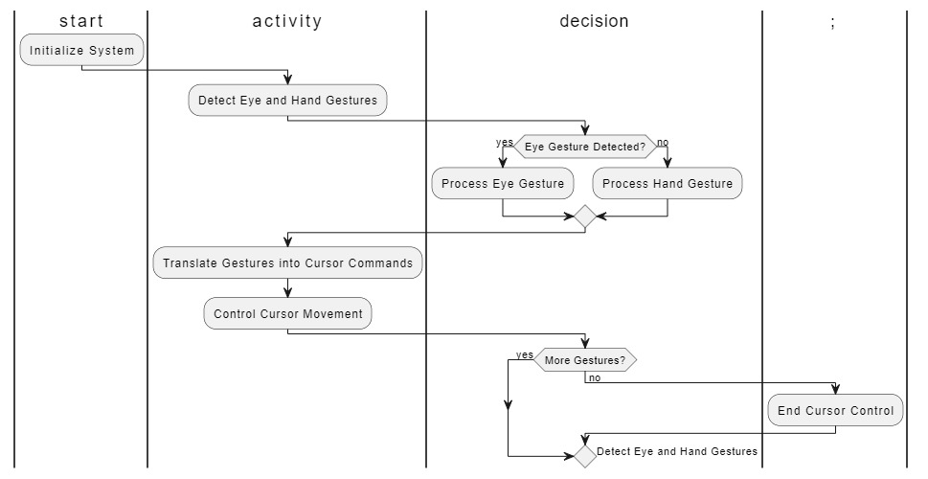
Cursor Pointer Control Using Eye and Hand Gestures
Activity Diagram

Slide 21
Cursor Pointer Control Using Eye and Hand Gestures
Application in Real World
Hands-Free Computing

Slide 22
Cursor Pointer Control Using Eye and Hand Gestures
Pseudo code
1. Initialize necessary libraries and modules such as OpenCV, mediapipe, pyautogui, etc.
2. Set up the camera and check if it's successfully opened.
3. Define functions to enable eye control, hand control, and exit the application.
3.1. Function enable_eye_control:
3.1.1. Set hand_control_var to False and eye_control_var to True.
3.1.2. Start a thread for eye control loop which continuously captures eye movements and controls mouse.
3.2. Function enable_hand_control:
3.2.1. Set eye_control_var to False and hand_control_var to True.
3.2.2. Initialize hand tracking detector.
3.2.3. Start a thread for hand control loop which continuously captures hand gestures and performs actions accordingly.

Slide 23
Cursor Pointer Control Using Eye and Hand Gestures
Pseudo code
3.3. Function exit_application:
3.3.1. If eye control thread is running, set eye_control_var to False and wait for it to finish.
3.3.2. If hand control thread is running, set hand_control_var to False and wait for it to finish.
3.3.3. Close the Tkinter window and exit the application.
4. Create the main Tkinter window.
5. Create radio buttons for enabling eye control and hand control.
6. Create an exit button.
7. Start the main event loop.
8. Define HandGesture module:

Slide 24
Cursor Pointer Control Using Eye and Hand Gestures
Pseudo code
8.1. Initialize necessary libraries and modules for hand gesture control.
8.2. Define function HandTracker:
8.2.1. Read frames from the camera.
8.2.2. Process the frames to detect hand landmarks.
8.2.3. Analyze hand gestures to perform actions like scrolling, adjusting volume, and controlling cursor.
8.2.4. Update the user interface with the actions performed.
8.2.5. Repeat the process in a loop until hand control is disabled.
9. Define EyeGesture module:
9.1. Initialize necessary libraries and modules for eye gesture control.
9.2. Define function EyeCaptureMovement:

Slide 25
Cursor Pointer Control Using Eye and Hand Gestures
Pseudo code
9.2.1. Read frames from the camera.
9.2.2. Process the frames to detect facial landmarks.
9.2.3. Analyze eye movements to perform actions like clicking and double-clicking.
9.2.4. Update the user interface with the actions performed.
9.2.5. Repeat the process in a loop until eye control is disabled.
10. Release the camera.

Slide 26
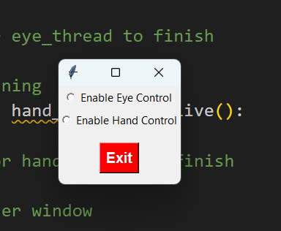
Cursor Pointer Control Using Eye and Hand Gestures
Screen Shots

Slide 27
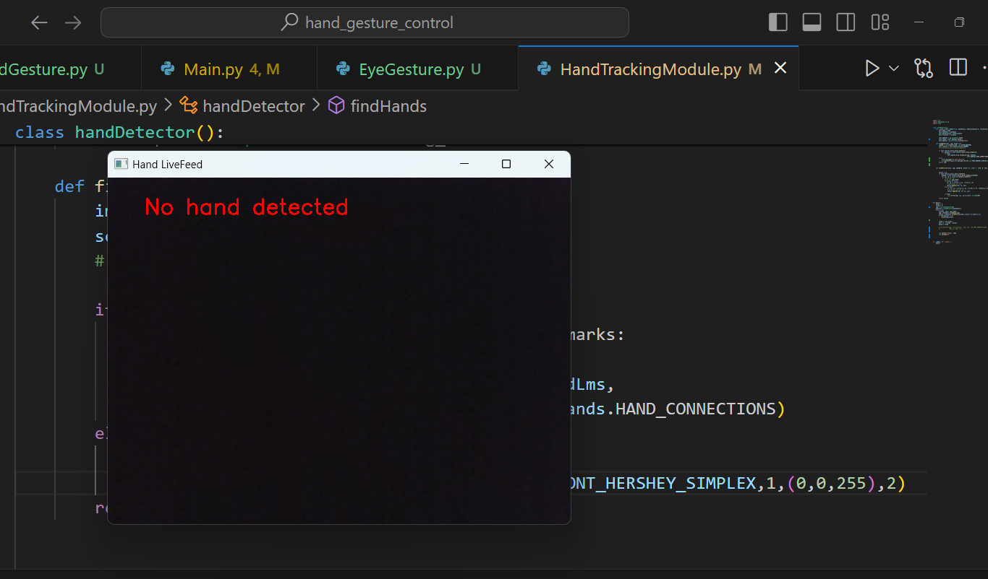
Cursor Pointer Control Using Eye and Hand Gestures
Screen Shots

Slide 28
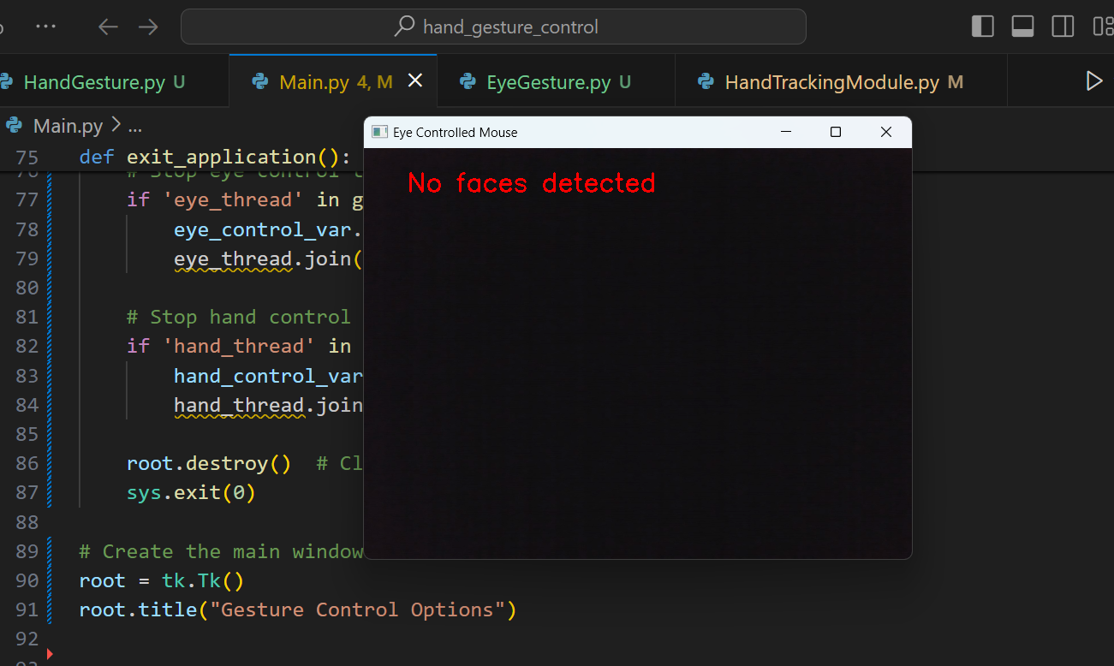
Cursor Pointer Control Using Eye and Hand Gestures
Screen Shots

Slide 29
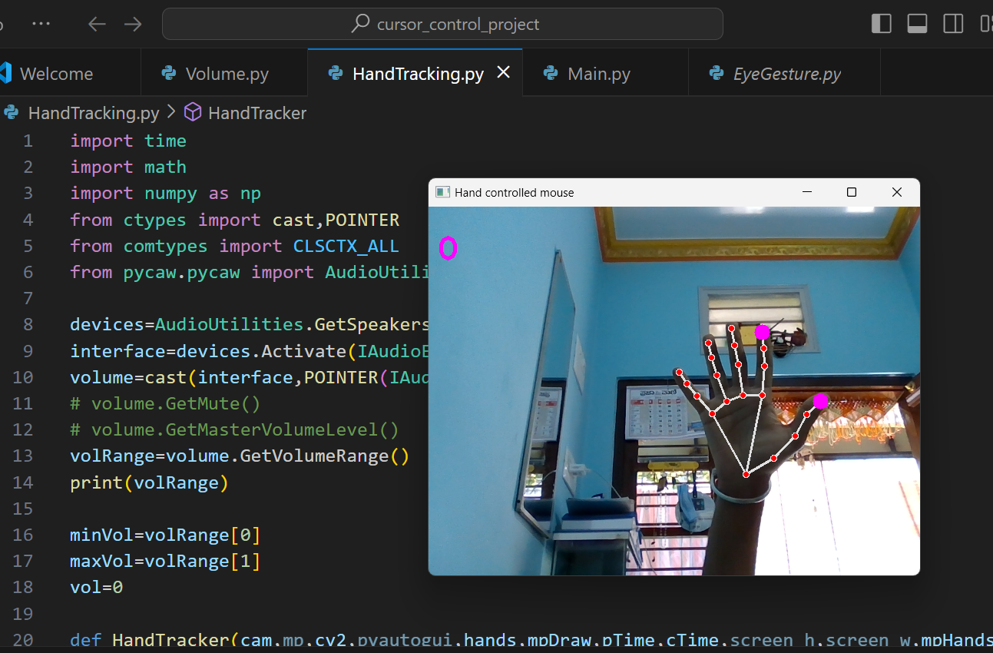
Cursor Pointer Control Using Eye and Hand Gestures
Screen Shots

Slide 30
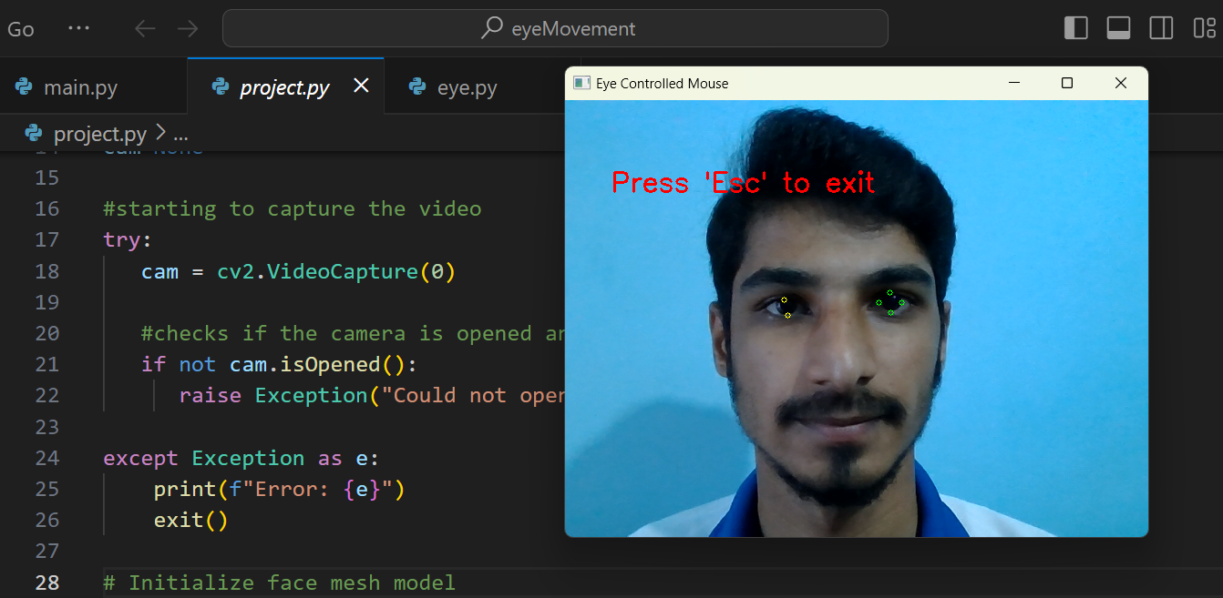
Cursor Pointer Control Using Eye and Hand Gestures
Screen Shots

Slide 31
Cursor Pointer Control Using Eye and Hand Gestures
Journals
Artificial Intelligence, IEEE Transactions on
Computational Social Systems, IEEE Transactions on
IEEE Robotics and Automation Letters
Affective Computing, IEEE Transactions on
Neural Systems and Rehabilitation Engineering, IEEE Transactions on
Cognitive and Developmental Systems, IEEE Transactions on
Software Engineering, IEEE Transactions on
Image Processing, IEEE Transactions on
Human-Machine Systems, IEEE Transactions on

Slide 32
Cursor Pointer Control Using Eye and Hand Gestures
References
“Eye tracking mouse for human-computer interaction” https://ieeexplore.ieee.org/document/6707244/
“Face and eye tracking for controlling computer functions” https://ieeexplore.ieee.org/document/6839834/
“Pupil center coordinates detection using the circular Hough transform technique” https://ieeexplore.ieee.org/document/7248041/
“Virtual Mouse Implementation using Open CV” https://www.jetir.org/papers/JETIR2006455.pdf/
“Gesture recognition with a Data Glove”.IEEE Conference on Aerospace and Electronics.

Slide 33

THANK YOU
BHARATH.S
PES1PG22CA044

